Slide 2
E-business Defined
E-Business (electronic business) is any process that a business organization conducts over a computer-mediated network. Business organizations include any for-profit, governmental, or nonprofit entity.
Their processes include production-, customer-, and internal- or management-focused business processes.

Slide 3
Electronic commerce focuses on the use of information and communication technology to enable the external activities and relationships of the business with individuals, groups, and other businesses, while e-business refers to business with help of the internet.
Electronic business differs from electronic commerce as it does not only deal with online transactions of selling and buying of a product and/or service but also enables to conduct of business processes (inbound/outbound logistics, manufacturing & operations, marketing and sales, customer service) within the value chain through internal or external networks.
The term "e-business" was coined by IBM's marketing and Internet team in 1996

Slide 4
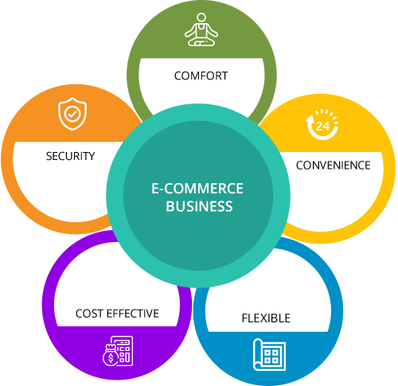
Why ????

